Slide 1
My Marble Billiards Reflections
Date:
Name:

Slide 2
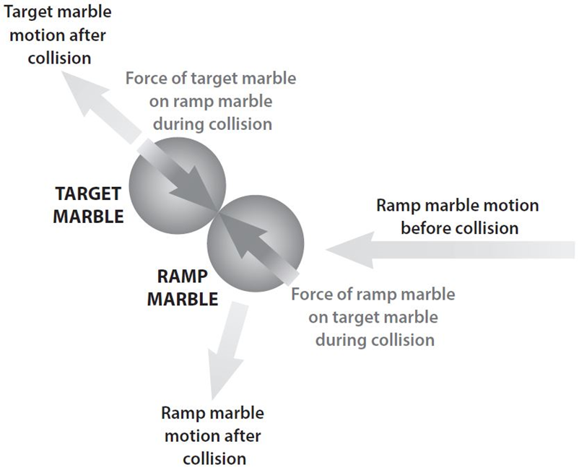
the focus question
Date:
How do Newton’s laws help us explain what was happening during the collision of the marbles? (you may use the illustrations to help you explain)

Slide 3
What I needed to do in the collision activity?
How did you get the target marble moving in the right direction to go through the goal?

Slide 4
What I discovered in the activity?
What determined the direction that the target marble moved after the collision?

Slide 5
What else was going on ?
Why didn’t the target marble move at the start?
Were there any forces acting on the marble? What were they?

Slide 6
What Newton’s first law had to with how the marbles acted …
Newton’s first law tells us that if the target marble started moving, a force was applied to it. What object applied a force on the target marble?

Slide 7
I also noticed …
When the ramp marble hit the target marble, did the ramp marble keep going in the same direction?

